Slide 1
A Family of Barycentric Coordinates for Co-Dimension 1 Manifolds with Simplicial Facets
Zhipei Yan and Scott Schaefer
Texas A&M University
July 8, 2019

Slide 2
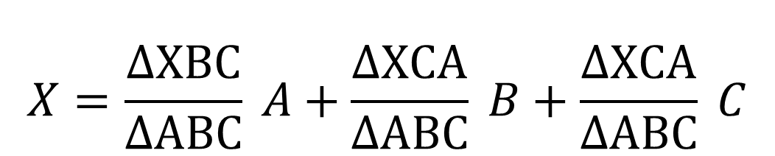
Barycentric coordinates
$$X=\frac{ΔXBC}{ΔABC} A+\frac{ΔXCA}{ΔABC} B+\frac{ΔXCA}{ΔABC} C$$
A
X
Coefficients are unique
B
C

Slide 3
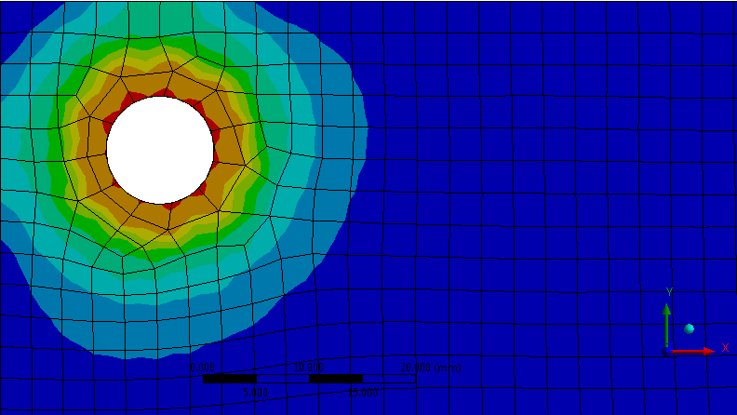
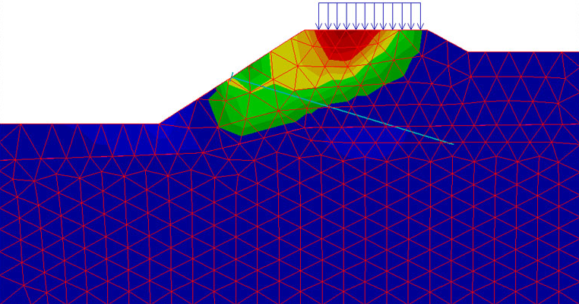
Finite Element Analysis

Slide 4
Parameterization
Input
Tutte Embedding
Shape-preserving
Mean Value
[Tutte 1963]
[Floater 1997]
[Floater 2003]

Slide 5
Orbifold Tutte Embedding
[Aigerman et al 2015]

Slide 6
Mean Value Image Cloning
[Farbman et al 2009]

Slide 7
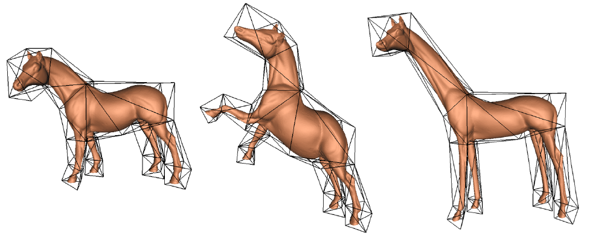
3D deformation
[Ju et al 2005]

Slide 8
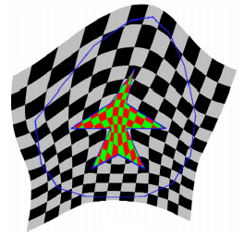
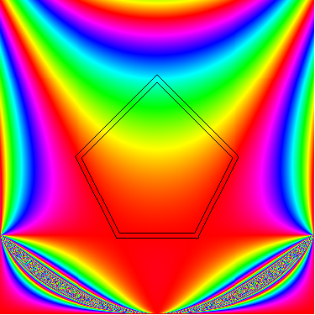
Barycentric Coordinates
[Wachspress et al 1975]
[Floater et al 2006]
[Hormann et al 2008]
[Pinkall et al 1993]
[Lipman et al 2008]
Notes:
Wachspress, MVC, Discrete Harmonic;
Maximum Entropy, Green.

Slide 9

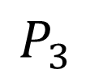
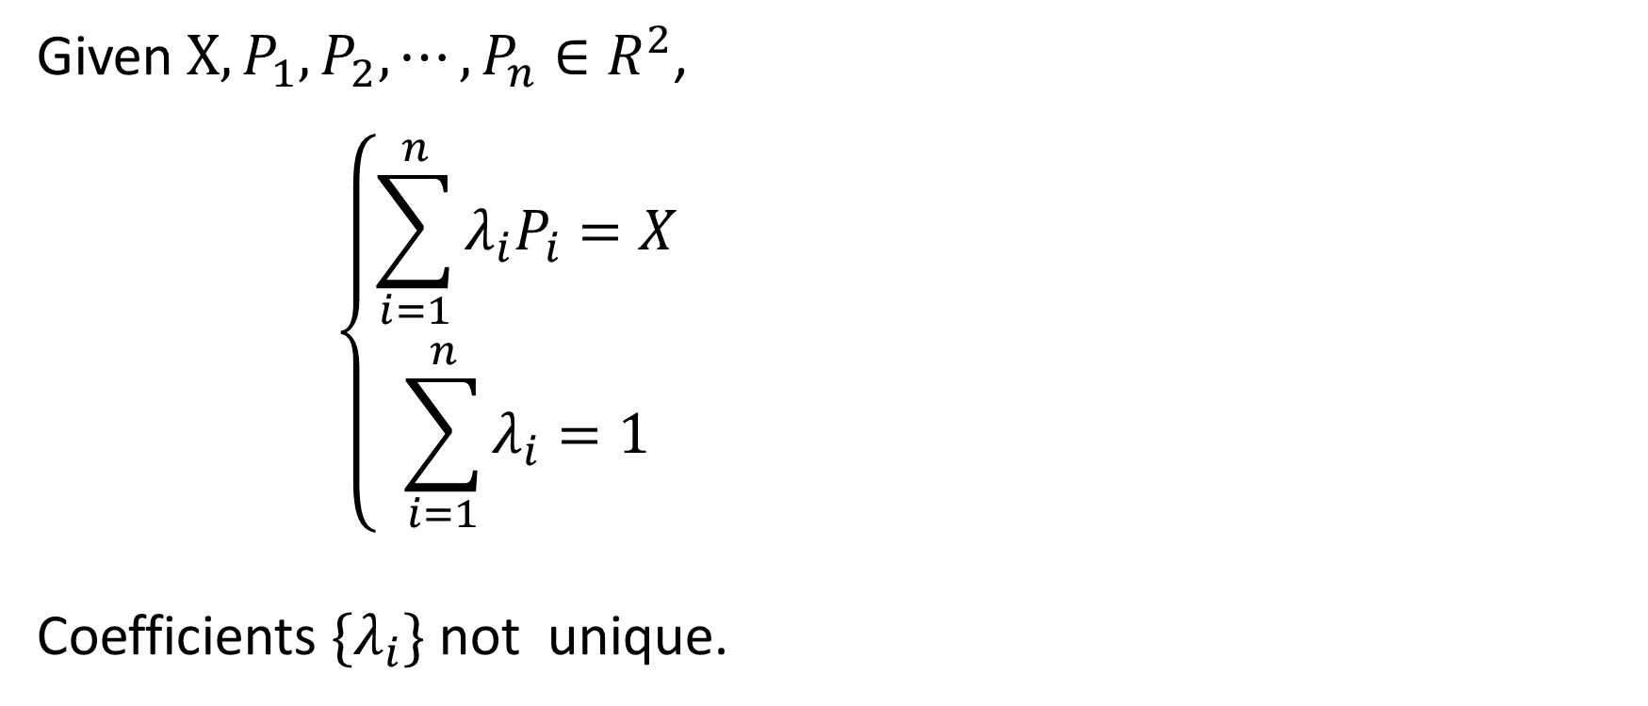
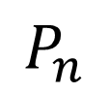
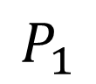
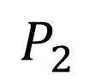
General Barycentric Coordinates
Given $X, P_{1},P_{2},⋯,P_{n}∈R^{2}$,
$$\left\{\begin{aligned}\sum_{i=1}^{n}{λ_{i}P_{i}}=X \\ \sum_{i=1}^{n}{λ_{i}}=1\end{aligned}\right.$$
Coefficients $\{λ_{i}\}$ not unique.
$$P_{1}$$
$$P_{2}$$
$$P_{n}$$
X
$$P_{3}$$
$$⋯$$

Slide 10
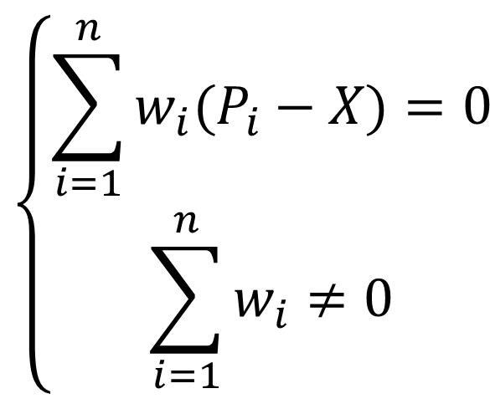
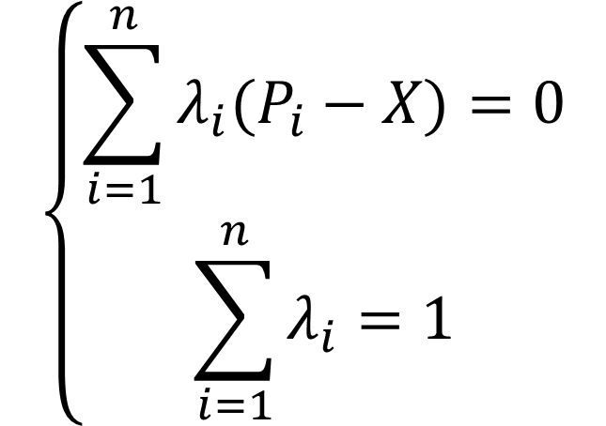
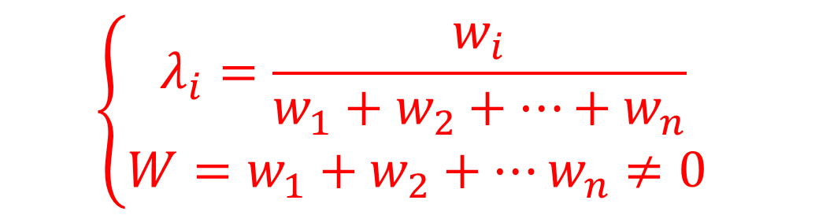
Homogeneous Barycentric Coordinates
$$\left\{\begin{aligned}\sum_{i=1}^{n}{w_{i}(P_{i}−X)}=0 \\ \sum_{i=1}^{n}{w_{i}}≠0\end{aligned}\right.$$
$$\left\{\begin{aligned}\sum_{i=1}^{n}{λ_{i}(P_{i}−X)}=0 \\ \sum_{i=1}^{n}{λ_{i}}=1\end{aligned}\right.$$
$$\left\{\begin{aligned}λ_{i}=\frac{w_{i}}{w_{1}+w_{2}+⋯+w_{n}} \\ W=w_{1}+w_{2}+⋯w_{n}≠0 \end{aligned}\right.$$

Slide 11
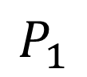

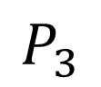
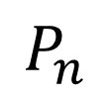
Floater-Hormann-Kos’ construction
[Floater, et al 2006]
$$P_{1}$$
$$P_{2}$$
$$P_{n}$$
X
$$P_{3}$$
$$⋯$$

Slide 12
Floater-Hormann-Kos’ construction
[Floater, et al 2006]
$$P_{1}$$
$$P_{2}$$
$$P_{n}$$
X
$$P_{3}$$
$$⋯$$

Slide 13
Floater-Hormann-Kos’ construction
[Floater, et al 2006]
$$P_{1}$$
$$P_{2}$$
$$P_{n}$$
X
$$P_{3}$$
$$⋯$$

Slide 15
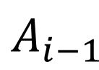
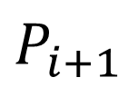
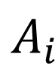
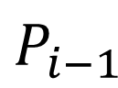

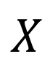
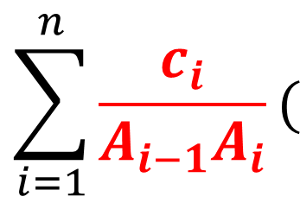
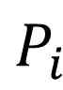
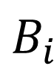
$$P_{i}$$
$$P_{i+1}$$
$$A_{i}$$
$$X$$
$$A_{i−1}$$
$$B_{i}$$
$$c_{i}={\left|P_{i}−X\right|}^{p}, p≥0$$
$$P_{i−1}$$
$$\sum_{i=1}^{n}{\frac{c_{i}}{A_{i−1}A_{i}}(}$$
$$A_{i}\left(P_{i−1}−X\right)+B_{i}\left(P_{i}−X\right)+A_{i−1}\left(P_{i+1}−X\right)=0$$
)

Slide 16


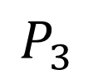
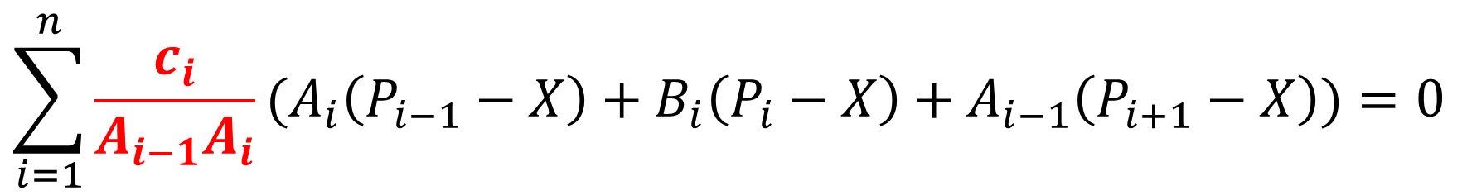
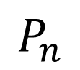
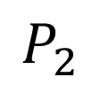
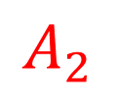
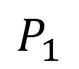
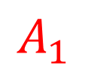
Floater-Hormann-Kos’ construction
$$\sum_{i=1}^{n}{\frac{c_{i}}{A_{i−1}A_{i}}}{(A}_{i}\left(P_{i−1}−X\right)+B_{i}\left(P_{i}−X\right)+A_{i−1}\left(P_{i+1}−X\right))=0$$
$$P_{1}$$
$$c_{i}={\left|P_{i}−X\right|}^{p}, p≥0$$
$$P_{2}$$
$$A_{1}$$
$$P_{n}$$
$$A_{2}$$
X
$$P_{3}$$
$$⋯$$

Slide 17
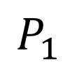

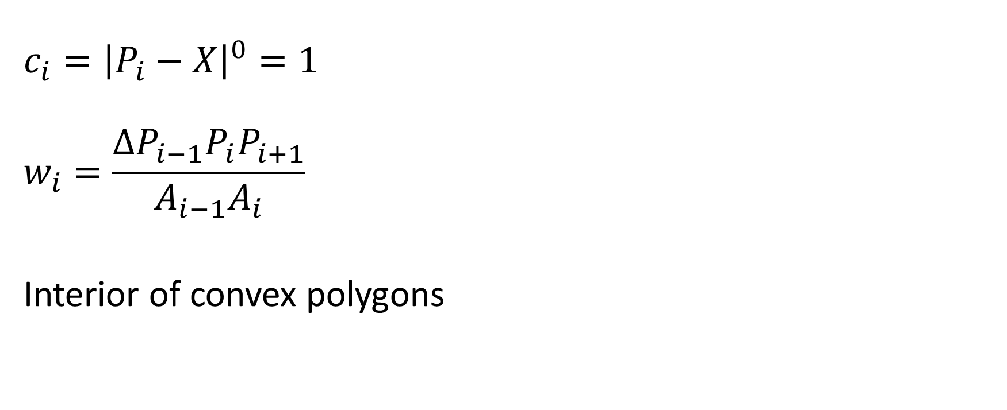
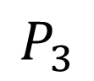
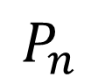
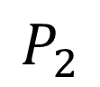
Wachspress’ Coordinates
$$c_{i}={\left|P_{i}−X\right|}^{0}=1$$
$$w_{i}=\frac{ΔP_{i−1}P_{i}P_{i+1}}{A_{i−1}A_{i}}$$
Interior of convex polygons
$$P_{1}$$
$$P_{2}$$
$$P_{n}$$
X
$$P_{3}$$
$$⋯$$

Slide 18
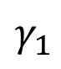
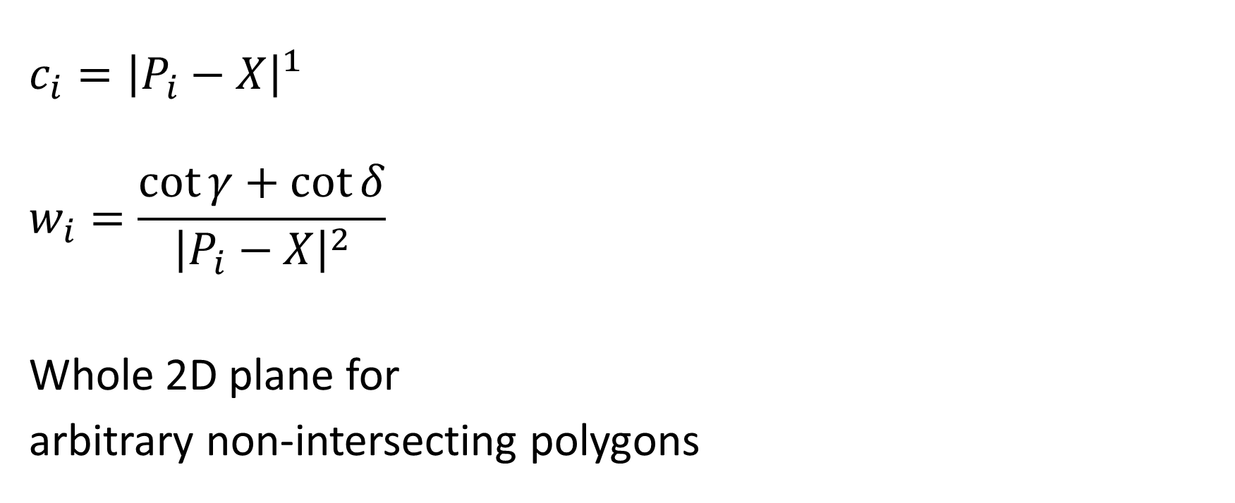
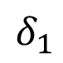
Mean Value Coordinates
$$c_{i}={\left|P_{i}−X\right|}^{1}$$
$$w_{i}=\frac{\cot{γ}+\cot{δ}}{{\left|P_{i}−X\right|}^{2}}$$
Whole 2D plane for
arbitrary non-intersecting polygons
$$P_{1}$$
$$γ_{1}$$
$$δ_{1}$$
$$P_{2}$$
$$P_{n}$$
X
$$P_{3}$$
$$⋯$$

Slide 19
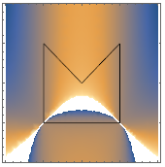
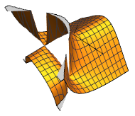
Main issue
The full family only works well for convex polygons.
E.g. Wachspress’ has poles in a concave polygon.

Slide 20

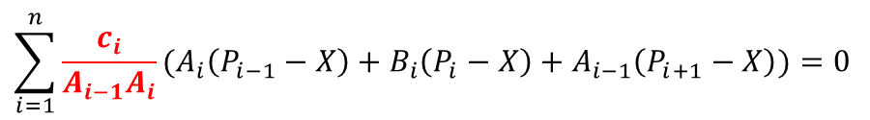
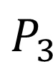
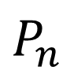
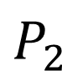
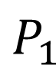
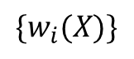
Why?
$$A_{i}\left(P_{i−1}−X\right)+B_{i}\left(P_{i}−X\right)+A_{i−1}\left(P_{i+1}−X\right)=0$$
$$P_{1}$$
$$P_{2}$$
$$P_{n}$$
$${\{w}_{i}(X)\}$$
X
$$\sum_{i=1}^{n}{\frac{c_{i}}{A_{i−1}A_{i}}}{(A}_{i}\left(P_{i−1}−X\right)+B_{i}\left(P_{i}−X\right)+A_{i−1}\left(P_{i+1}−X\right))=0$$
$$P_{3}$$
$$⋯$$

Slide 21
Homogeneous Barycentric Coordinates
$$\left\{\begin{aligned}\sum_{i=1}^{n}{w_{i}(P_{i}−X)}=0 \\ \sum_{i=1}^{n}{w_{i}}≠0\end{aligned}\right.$$
$$\left\{\begin{aligned}\sum_{i=1}^{n}{λ_{i}(P_{i}−X)}=0 \\ \sum_{i=1}^{n}{λ_{i}}=1\end{aligned}\right.$$
$$\left\{\begin{aligned}λ_{i}=\frac{w_{i}}{w_{1}+w_{2}+⋯+w_{n}} \\ W=w_{1}+w_{2}+⋯w_{n}≠0 \end{aligned}\right.$$

Slide 22
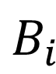
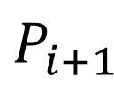





Why?
$$W=\sum_{i=1}^{n}{\frac{c_{i}}{A_{i−1}A_{i}}}{(A}_{i}+B_{i}+A_{i−1})$$
$$=\sum_{i=1}^{n}{\frac{c_{i}}{A_{i−1}A_{i}}}ΔP_{i−1}P_{i}P_{i+1}>0$$
$A_{i}$>0 for convex shape only
$$P_{i}$$
$$P_{i+1}$$
$$A_{i}$$
$$A_{i−1}$$
$$B_{i}$$
?
$$P_{i−1}$$

Slide 23

What do we need?
$$\sum_{i=1}^{n}{f_{i}}{(A}_{i}\left(P_{i−1}−X\right)+B_{i}\left(P_{i}−X\right)+A_{i−1}\left(P_{i+1}−X\right))=0$$
When $X→P_{i}P_{i−1}$ or $P_{i}P_{i+1}$, $f_{i}→+∞$
$$2. \sum_{i=1}^{n}{f_{i}}{(A}_{i}+B_{i}+A_{i−1})>0$$

Slide 24


How we did it
$$W=\sum{\frac{c_{i}}{A_{i−1}A_{i}}}ΔP_{i−1}P_{i}P_{i+1}$$
FHK:
$$W=\sum{\frac{c_{i}\sin{∠φ_{i}}}{d_{i−1}^{β}d_{i}^{β}}}ΔP_{i−1}P_{i}P_{i+1}$$
> 0
Our:

Slide 25






Numerator
$$P_{i}$$
$$P_{i+1}$$
$$φ_{i}$$
$$X$$
$$\sin{∠φ_{i}}⋅ΔP_{i−1}P_{i}P_{i+1}>0$$
$$P_{i−1}$$

Slide 26







Denominator
$$P_{i}$$
$$P_{i}$$
$$P_{i+1}$$
$$P_{i+1}$$
$$X$$
$$X$$
$$A_{i}=\frac{1}{2}\left|P_{i}P_{i+1}\right|⋅h$$
$$d_{i}=\left|P_{i}−X\right|+\left|P_{i+1}−X\right|−|P_{i+1}−P_{i}|$$
Area(Distance to a line)
Distance to a segment

Slide 27



Denominator
$$P_{i}$$
$$P_{i}$$
$$P_{i+1}$$
$$P_{i+1}$$
$$X$$
$$X$$
$$A_{i}=\frac{1}{2}\left|P_{i}P_{i+1}\right|⋅h$$
$$d_{i}=\left|P_{i}−X\right|+\left|P_{i+1}−X\right|−|P_{i+1}−P_{i}|$$
>0
Area(Distance to a line)
Distance to a segment

Slide 28









Our Construction
$$P_{i}$$
$$P_{i+1}$$
$$φ_{i}$$
$$A_{i}$$
$$X$$
$$A_{i−1}$$
$$B_{i}$$
$$\sum_{i=1}^{n}{\frac{c_{i}\sin{∠φ_{i}}}{d_{i−1}^{β}d_{i}^{β}}}{(A}_{i}\left(P_{i−1}−X\right)+B_{i}\left(P_{i}−X\right)+A_{i−1}\left(P_{i+1}−X\right))=0$$
$$P_{i−1}$$

Slide 29


Our Construction
$$A_{i}\left(P_{i−1}−X\right)+B_{i}\left(P_{i}−X\right)+A_{i−1}\left(P_{i+1}−X\right)=0$$
$$P_{1}$$
$$\frac{c_{i}}{A_{i−1}A_{i}}$$
$$P_{2}$$
$$P_{n}$$
$${\{w}_{i}(X)\}$$
X
$$\sum_{i=1}^{n}{\frac{c_{i}\sin{∠φ_{i}}}{d_{i−1}^{β}d_{i}^{β}}}{(A}_{i}\left(P_{i−1}−X\right)+B_{i}\left(P_{i}−X\right)+A_{i−1}\left(P_{i+1}−X\right))=0$$
$$P_{3}$$
$$⋯$$

Slide 30


Our Construction
$$P_{i}$$
$$P_{i+1}$$
$$φ_{i}$$
$$A_{i}$$
$$w_{i}=\frac{c_{i−1}\sin{φ_{i−1}A_{i−2}}}{d_{i−2}^{β}d_{i−1}^{β}}+\frac{c_{i}\sin{φ_{i}B_{i}}}{d_{i−1}^{β}d_{i}^{β}}+\frac{c_{i+1}\sin{φ_{i+1}A_{i+1}}}{d_{i}^{β}d_{i+1}^{β}}$$
$$X$$
$$A_{i−1}$$
$$B_{i}$$
$$\sum_{i=1}^{n}{w_{i}}>0$$
$$P_{i−1}$$

Slide 31


Wachspress
Mean Value
Our Method

Slide 32


Wachspress
Mean Value
Our Method

Slide 33



















Degenerated cases
$$P_{1}$$
$$P_{7}$$
$$P_{1}$$
$$P_{7}$$
$$P_{2}$$
$$P_{2}$$
$$P_{2}$$
$$P_{2}$$
$$P_{3}$$
$$P_{3}$$
$$P_{3}$$
$$P_{4}$$
$$P_{4}$$
$$P_{4}$$
$$P_{4}$$
$$P_{5}$$
$$P_{6}$$
$$P_{5}$$
$$P_{6}$$

Slide 34

Basis functions

Slide 35

Input
Mean Value
Our Method

Slide 36


Shape parameter
$$\sum_{i=1}^{n}{\frac{c_{i}\sin{∠φ_{i}}}{d_{i−1}^{β}d_{i}^{β}}}{(A}_{i}\left(P_{i−1}−X\right)+B_{i}\left(P_{i}−X\right)+A_{i−1}\left(P_{i+1}−X\right))=0$$
$$β$$

Slide 37



Shape parameter
Input
$$β=1$$

Slide 38


Shape parameter
Input
$$β=1.5$$

Slide 39


Shape parameter
Input
$β=$2

Slide 40

Extension to 3D
2D
3D

Slide 41


Extension to 3D
$$X$$
$$X$$
2D
3D

Slide 42







Extension to 3D
$$P_{i}$$
$$P_{i+1}$$
$$P4$$
$$P3$$
$$X$$
$$X$$
$$P1$$
$$P_{i−1}$$
$$P2$$
2D
3D

Slide 43

Extension to 3D
$$P4$$
$$V^{1}=Vol(X, P^{2},P^{3},P^{4})$$
$$V^{2}=Vol(P^{1},X,P^{3},P^{4})$$
$$V^{3}=Vol(P^{1}, P^{2},X,P^{4})$$
$$V^{4}=Vol(P^{1}, P^{2},P^{3},X)$$
$$P3$$
$$X$$
$$P1$$
$$P2$$
$$V^{1}\left(P^{1}−X\right)+V^{2}\left(P^{2}−X\right)+V^{3}\left(P^{3}−X\right)+V^{4}\left(P^{4}−X\right)=0$$

Slide 44


Extension to 3D
$$d^{1}=ΔXP^{2}P^{1}+ΔXP^{3}P^{2}+ΔXP^{1}P^{3}−ΔP^{1}P^{2}P^{3}$$
$$d^{2}=ΔXP^{1}P^{4}+ΔXP^{4}P^{3}+ΔXP^{3}P^{1}−ΔP^{1}P^{3}P^{4}$$
$$P4$$
$$P3$$
$$X$$
$$P1$$
$$\sin{φ=\frac{3}{2}\frac{Vol\left(P^{1},P^{2},P^{3},P^{4}\right)⋅|P^{1}−P^{3}|}{\left|ΔP^{1}P^{2}P^{3}\right|⋅|ΔP^{1}P^{3}P^{4}|}}$$
$$P2$$

Slide 45

Extension to 3D
Traverse all triangle pairs sharing exactly one edge:
$$\sum_{i}{\frac{c_{i}\sin{∠φ_{i}}}{d_{i−1}^{β}d_{i}^{β}}}(V_{i}^{1}\left(P_{i}^{1}−X\right)+V_{i}^{2}\left(P_{i}^{2}−X\right)+V_{i}^{3}\left(P_{i}^{3}−X\right)+V_{i}^{4}\left(P_{i}^{4}−X\right))=0$$

Slide 46



Examples

Slide 47






Slide 48

Degenerated cases

Slide 49

Examples

Slide 50

Higher dimensions
In $ℝ^{k}$:
$$\sum_{i}{\frac{c_{i}\sin{∠φ_{i}}}{d_{i−1}^{β}d_{i}^{β}}}(\sum_{j=1}^{k+1}{V_{i}^{j}\left(P_{i}^{j}−X\right)})=0$$
$$W=\sum_{i}{\frac{c_{i}\sin{∠φ_{i}}}{d_{i−1}^{β}d_{i}^{β}}}V_{i}>0$$

Slide 51




Higher dimensions
$$d^{1}=\sum_{e∈E(f^{1})}{Vol(x,e)}−Vol\left(f^{1}\right)$$
$$d^{2}=\sum_{e∈E(f^{2})}{Vol(x,e)}− Vol\left(f^{2}\right)$$
$$f^{1}$$
$$X$$
$$f^{2}$$
$$\sin{φ=k\frac{Vol\left(f^{1}∪f^{2}\right)⋅Vol\left(f^{1}∩f^{2}\right)}{\left|Vol\left(f^{1}\right)\right|⋅|Vol\left(f^{2}\right)|}}$$
[Gangsong et al 1996]

Slide 52
Conclusion
Generalize the construction of FHK barycentric coordinates;
Convex polygons to arbitrary polyline structures;
Extended to arbitrary dimensions.

Slide 53

Limitations
Require the boundary facets to be (n-1)-dim in $ℝ^{n}$.
In 3D, only triangular meshes are applicable.
There must be at least one pair of connected facets.
Totally separate facets will generate all zero coordinates.
Non injective

Slide 54

Input
Mean Value
Our Method

Slide 55
Questions?
Thanks!

